Slide 1

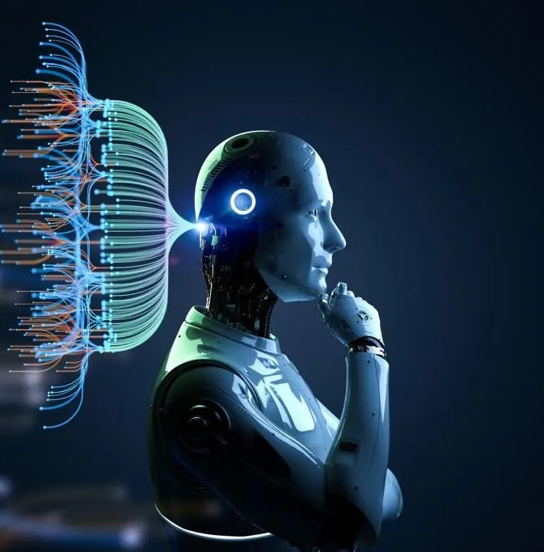

Real-Time
AI-Powered Health Coach for Diabetes

Slide 2

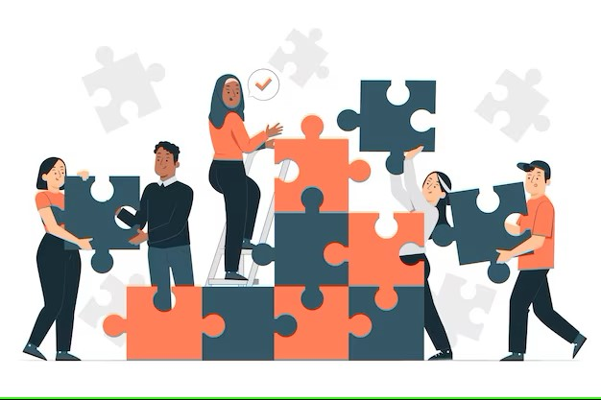
Ashna Ali Sai Kiran Basetty Sreevardhan Reddy Soma Venkata Sai Veeramalla
Who We Are…..?
DATA DIVERS

Slide 3
What we have done (past)
SINGLE MODEL:
Created a Single Deep Learning model that can work for both males and female parts, Included basic features according into user needs, deployed using flask.
NO RECOMMENDATION:
As a simple model and architecture we are not included the Recommendation feature that need to display along with predicted result at end.
BASIC UI:
We just started with Basic UI where the features for both male and female view at single page and prediction as well.

Slide 4

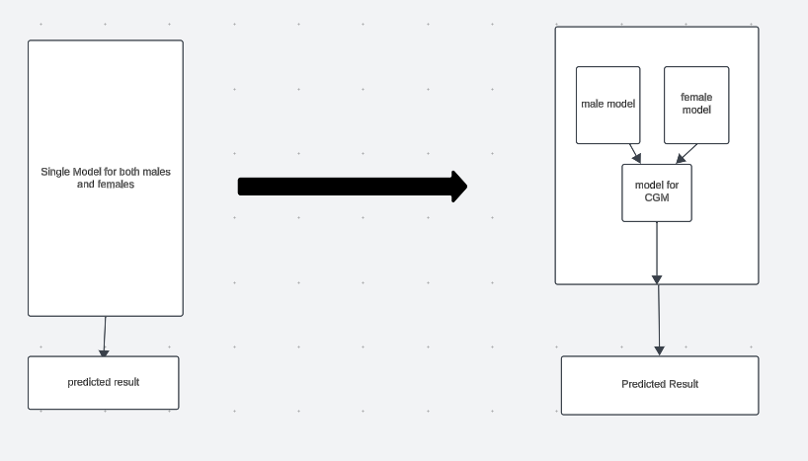
WhAT We changed ?
DUAL MODEL:
Why?
By implementing the Dual model method we can make the Gender specific features(i.e PCOS, No.of.Pregencies for female ) and the data that is generated can help for gender specific studies in future.
How?
We used the “XGBoost” machine learning model for both male and Female data’s which fetched a higher accuracy (Female: 82%, male : 91% ) than when combined(35%).

Slide 5
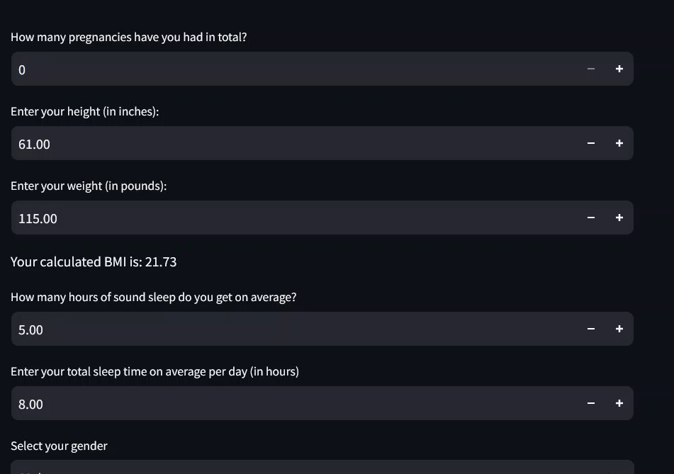
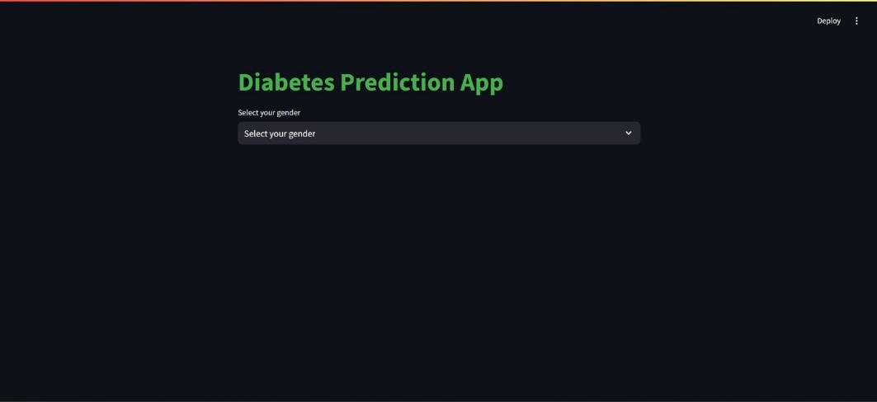
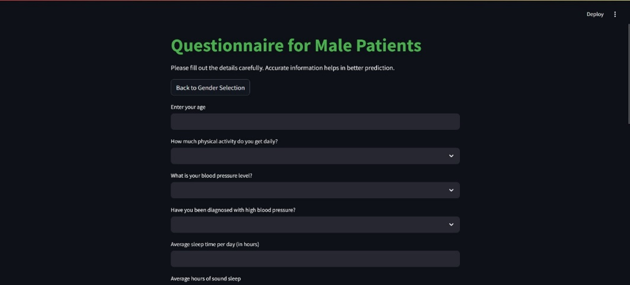
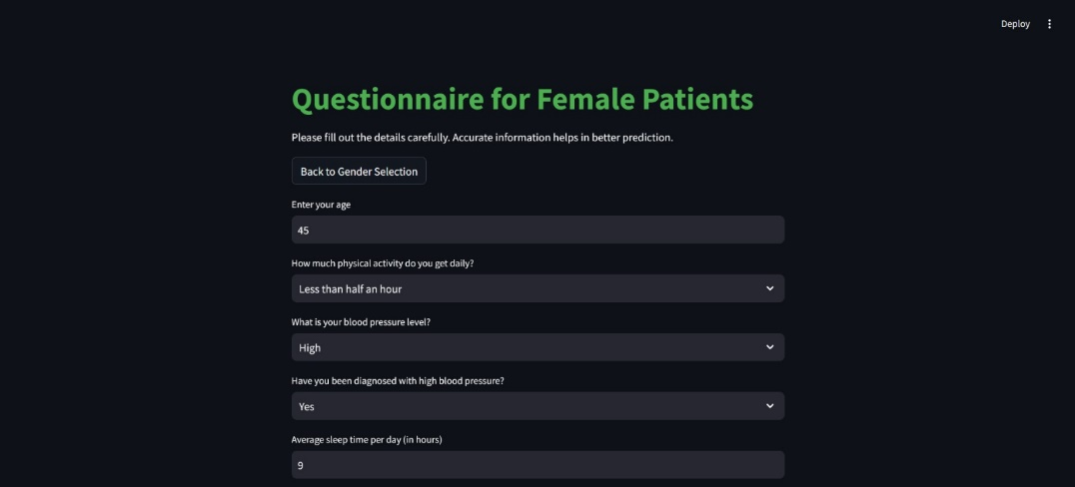
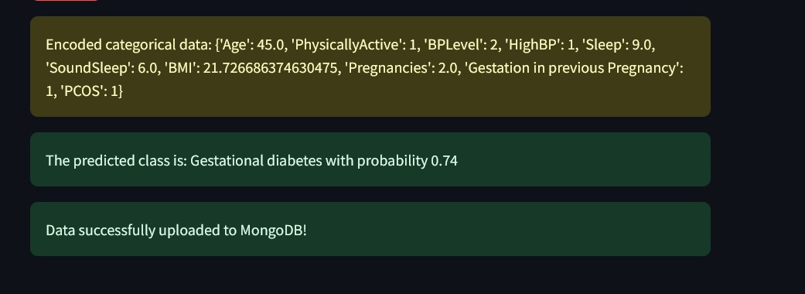
What we changed(Continued)
Build Basic UI related to dual model :
We build the basic UI for Dual model that have three pages (gender selection, questionnaire for female, questionnaire for male ) for creating more interaction to user.
OLD NEW

Slide 6

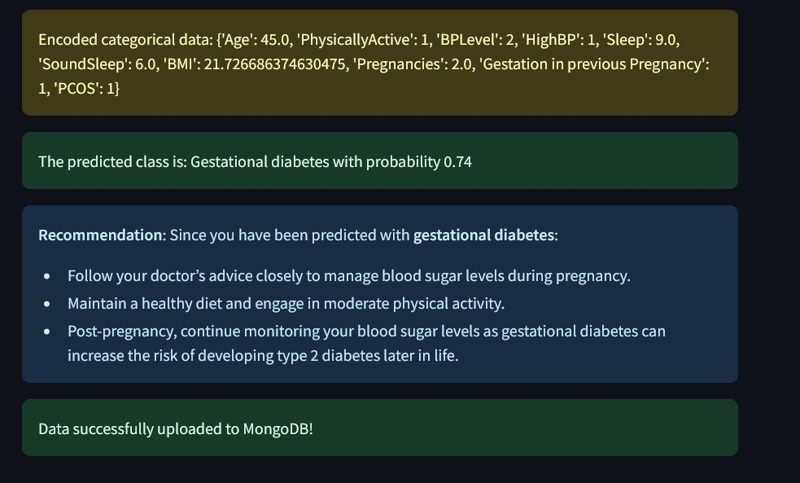
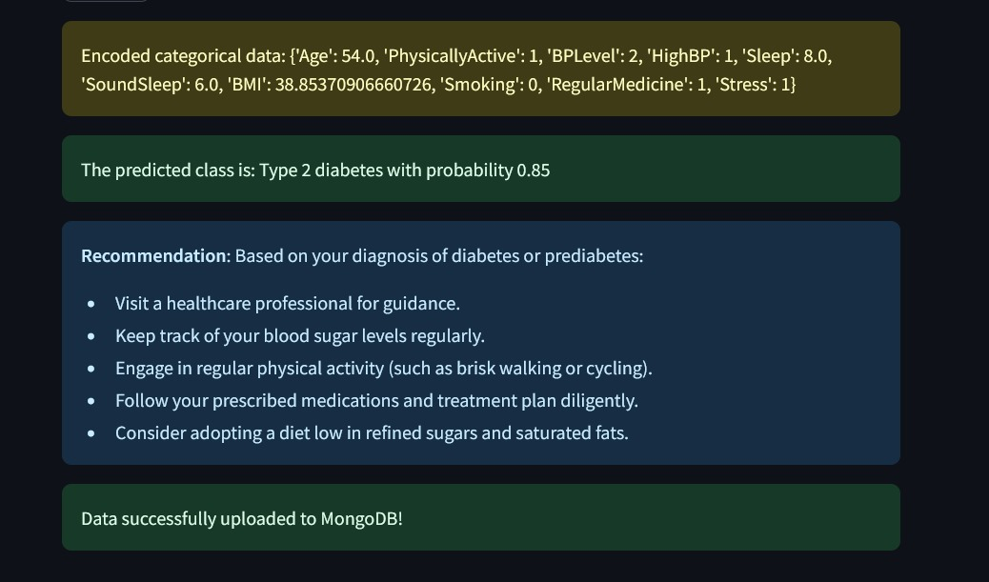
What we changed(Continued)
RECOMMENDATIONS BASED ON GIVEN DATA:
We included the Recommendations based on given data by user at the end step along with predicted result

Slide 7
FUTURE WORKS:
Integration of CGM Data:
Current CGM models achieve 99% accuracy but predict only 2 categories (No Diabetes, Type-2 Diabetes).
Future updates will extend to 3 categories for males and 4 categories for females.
LLM Integration for Recommendations:
LLM-based recommendations encountered runtime issues, so standard recommendations are used temporarily.
Next update will fix LLM integration to enhance personalized guidance

Slide 8
FUTURE WORKS:
Gender-Specific UI Enhancement:
Dual model mechanism with basic UI is implemented.
Next update will feature creative, gender-specific UIs for better interaction and experience
User Accounts for Personalized Recommendations:
Future updates will enable account creation for personalized insights.
Users will receive custom recommendations and guidance for diabetes management.

Slide 9
CONCLUSION
Revolutionize early detection and management of diabetes using machine learning, structured health data, and CGM data. Dual models for males and females ensure tailored predictions, improving accuracy and relevance. The goal is to deliver reliable insights for better health outcomes in the fight against diabetes

Slide 10
Thank You...!
Team Data Divers
Collaborate, Innovate, Deliver

